Slide 1
welcome

Slide 2
Your trainer
Notes:
Trainer: Change pic & text

Slide 3
Course times
9.30am - 4.30pm
Lunch ending… 1.00pm
Breaks: 11am, 2.30pm, + more …
Notes:
Discuss breaks

Slide 4
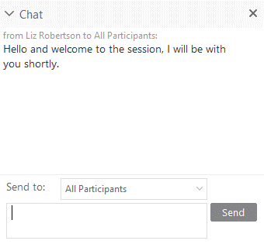
CHAT WINDOW
Ask & Answer Questions
Add Comments
Notes:
Trainer: Ask everyone to change “Send To” to All Participants and use this setting throughout the course
Benefits: Everyone then sees questions, answers & comments from everyone and feels more connected
Check if everyone has “All Participants”: “Where are you and how’s the weather”
If participants can’t see “All Participants”, check it’s ticked in Participants Menu / Assign Privileges – will be covered later

Slide 5
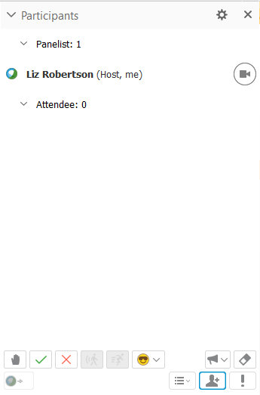
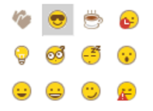
EMOJIS
How are you feeling?
Need a coffee?
Finding a topic interesting?
Yes / No
Notes:
Trainer: Emojis
Session Options / Feedback must be ticked to display panel
Mention - use regularly to confirm understanding of a topic / ask a quick question / Coffee Cup when away etc..
Raised Hand: Show that it displays numbers for the Host (View / Session Window)
Show: Clear All Annotations button

Slide 6
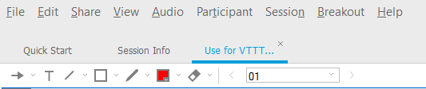
Annotation Tools
Notes:
Trainer: Annotation Arrows
Are they switched off? Participants Panel / Assign Privileges / Annotate must be ticked
Ask learners to use arrow to point to the “green” area on screen – check everyone can see and use the arrow
When in screenshare you must give them rights to annotate – on your Annotation Panel “All Attendees” must be ticked
Show: How to clear ALL Annotations
Slide 8 - use for Introductions

Slide 7
Questions?
Just ask

Slide 8
Course topics

Slide 9
Course materials

Slide 10
Introductions

Slide 11
Basic
Intermediate
Expert
Your
Experience

Slide 12
Your role?

Slide 13
What are your Objectives for the event?
1
2
3
4
5
6
7
8
9
10
11
12
Notes:
Trainer: Annotation Tools
Ask Trainers to choose a Lane Number and stick to this during day
Read out the answers

Slide 14
Let’s get started…

Slide 15
LUNCHTIME CHECKIN
How are you feeling about the course and topic?
How are you feeling about the content so far?
Is the pace correct?
Is it at the right level?
Do you have any questions about it?
Do you see how this could be useful for your role?
Any difficulties with delivery approach or courseware?

